Slide 1

PIONEER FABRICATORS LTD.
An ISO 9001 : 2015 Company

Slide 2
BRIEF INTRODUCTION
COMPANY ESTABLISHED IN THE YEAR 1987 BY LATE SH. RAJEEV KUMAR AGARWAL
CURRENT PROMOTERS OF THE COMPANY
  - Mr. Prakher Rajeev, B. Tech, IIT Dhanbad & MBA ISB, Hyderabad
TWO MANUFACTURING PREMISES LOCATED AT MEERUT HAVING TOTAL AREA OF 15000 Sqm
AVAILABLE MANUFACTURING CAPACITY 12000 MT/ANNUM

Slide 3
MAJOR EXPERIENCE
More than 4 Lacs SqM. of Pre-Engineered, Pre – Fabricated Metro stations constructed for Delhi Metro Rail Corporation at Delhi, Jaipur, Mumbai on Design Build Basis.
Recently constructed 17 stations at Line 2A of Mumbai Metro
  Total Covered Area 1,00,000 SqM
  Total tonnage of work: 6,550 MT
  Completion Period of 16 months from availability of site
Fabrication, Erection and Launching of More than 25,000 MT of RDSO Approved steel bridges done for various divisions of Indian Railways
Recently constructed India’s largest FOB at Varanasi Cantt Station which is to be inaugurated by the Honorable Prime Minister of India.
  Total Quantity – 1200 MT
  10 meter wide and 140 meter long
  End launching done using push and pull method in blocks provided by Railway.

Slide 4
MAJOR ACHIEVEMENTS
CONSTRUCTED OIL DEPOT FOR IOCL AT LADAKH DURING THE KARGIL WAR
CONSTRUCTED THE STEEL STRUCTURE DOME FOR METRO BHAWAN AT A HEIGHT OF 50 METERS
BECAME LARGIEST SUPPLIER OF LOCOMOTIVE CHASSIS TO DIESEL LOCOMOTIVE WORK IN THE YEAR 2016, 2017
PART OF THE COMPANIES THAT CONTRIBUTED TO CONSTRUCTION OF BANDRA WORLI SEA LINK, THE LARGEST SEA BRIDGE IN INDIA
REGULAR VENDOR OF DMRC SINCE ITS INCORPORATION AND STARTING WORK SINCE 2003
PART OF THE COMPANIES THAT CONTRIBUTED TO CONSTRUCTION OF NAINI BRIDGE, ALLAHABAD, THE CABLE STAYED
ONLY ONE MAJOR FATALITIES RECORDED AT CONSTRUCTION SITES TILL DATE

Slide 5
APPROVALS
ISO 9001:2015
Approved by RDSO since 2006 for Fabrication and Erection of Railway spans, Approved by Chief Controller of Explosives since 1993 for manufacturing pressure vessels
Approved by DIESEL LOCOMOTIVE WORKS, VARANASI since 2009 for manufacturing of locomotive chassis
BHEL – HARIDWAR
BHEL – BHOPAL
BHEL – VARANASI
BHEL – HYDERABAD

Slide 6
MANUFACTURING FACILITIES
COVERED AREA – 3 BAYS WITH TOTAL COVERED AREA OF 6000 SqM
TEMPLATE LAYOUT AREA- 3 NOS
10mtr x 4mtr
4mtr x 22mtr
6.5mtr x 4mtr
OXY FUEL AND PLASMA CNC CUTTING MACHINES – 2 NOS
  BED SIZE 3000 X 13000 MM (Thickness Up to 200mm)
CNC DRILLING MACHINE WITH 2 SPINDLE – 1 NO.
  BED SIZE 2500 X 2500 MM (Drill Thickness Up to 50mm)
BEAM/FLANGE STRAIGHTENING MACHINE – 1 NO.
BEAM FITUP BEDS – AREA OF 10 METERS X 50 METERS
ASSEMBLY AREA- 25MTR X 80MTR
STACKING AREA- 22MTR X 30MTR
BEAM WELDING – 6 NOS SAW MACHIINES
MIG MACHINES – 20 NOS
SMAW MACHINES- 20 NOS
BROACH CUTTERS – 20 NOS, MAX DIA 60 MM AND THICK 100 MM
SAND BLASTING & PAINTING – COVERED AREA OF 800 Sqm. WITH FOUR COMPRESSORS AND CORRESPONDING EQUIPMENTS & 4 AIRLESS MACHINES
EOT CRANES – 7 NOS WITH MAXIMUM LIFITING CAPACITY OF 75 MT
MOBILE CRANES – 2 Nos hydra for shifting & Loading Material

Slide 7
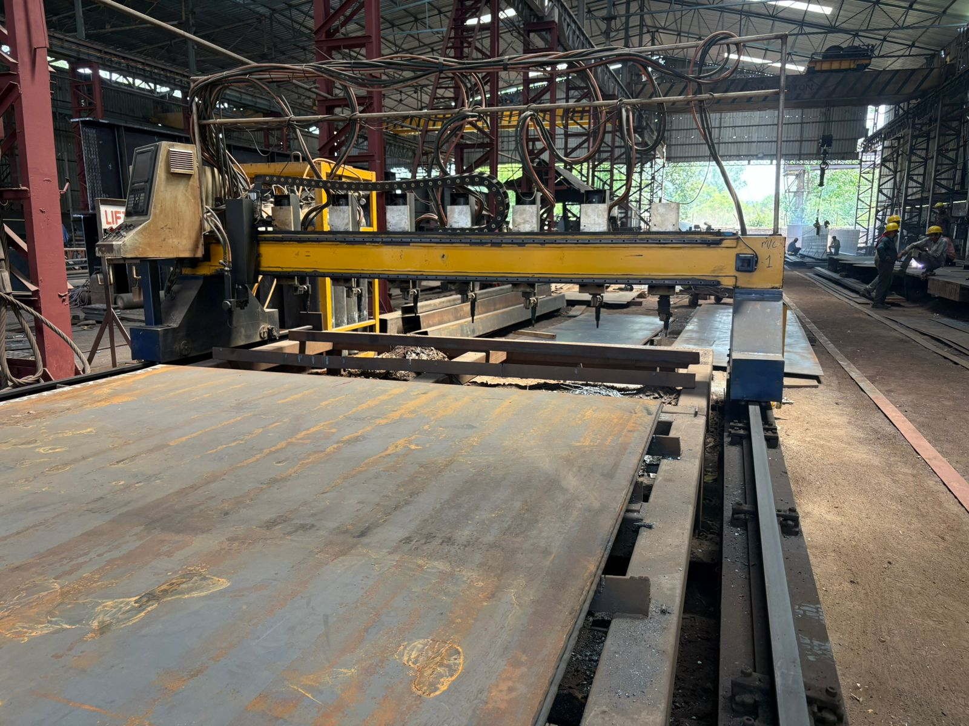
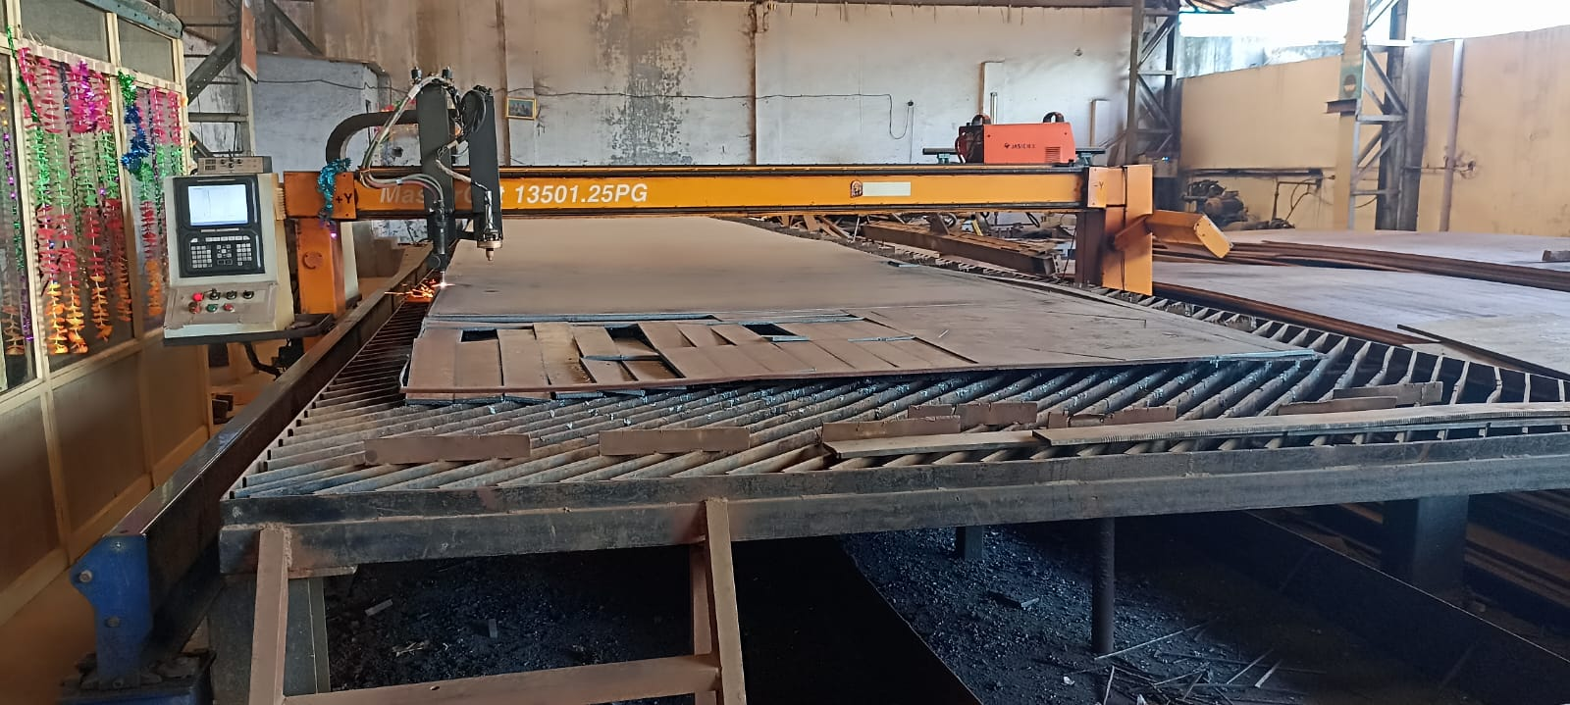
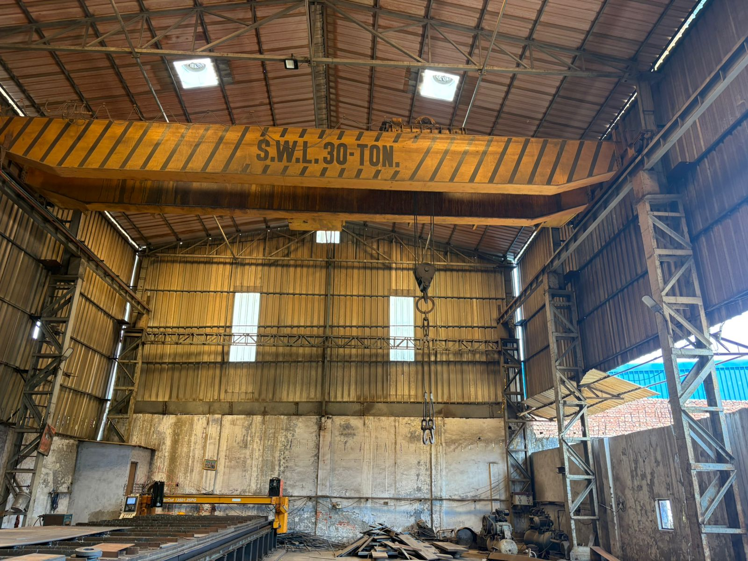
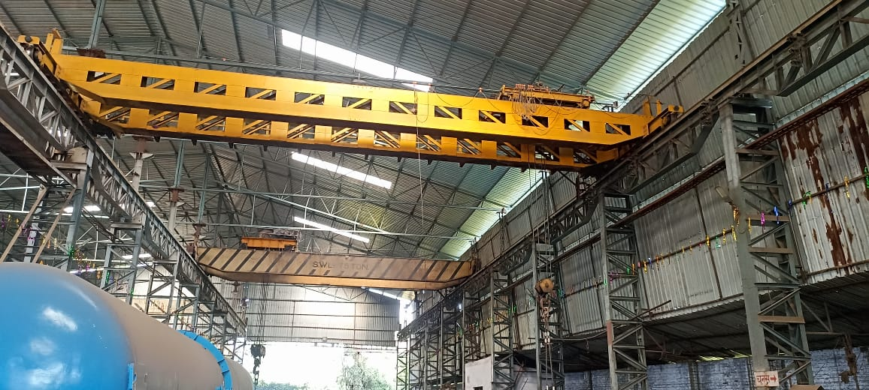
PLANT & EQUIPMENT
CNC PLASMA CUTTING 1
CNC PLASMA / OXY CUTTING 2
EOT CRANES (7 in 4 Bays)

Slide 8
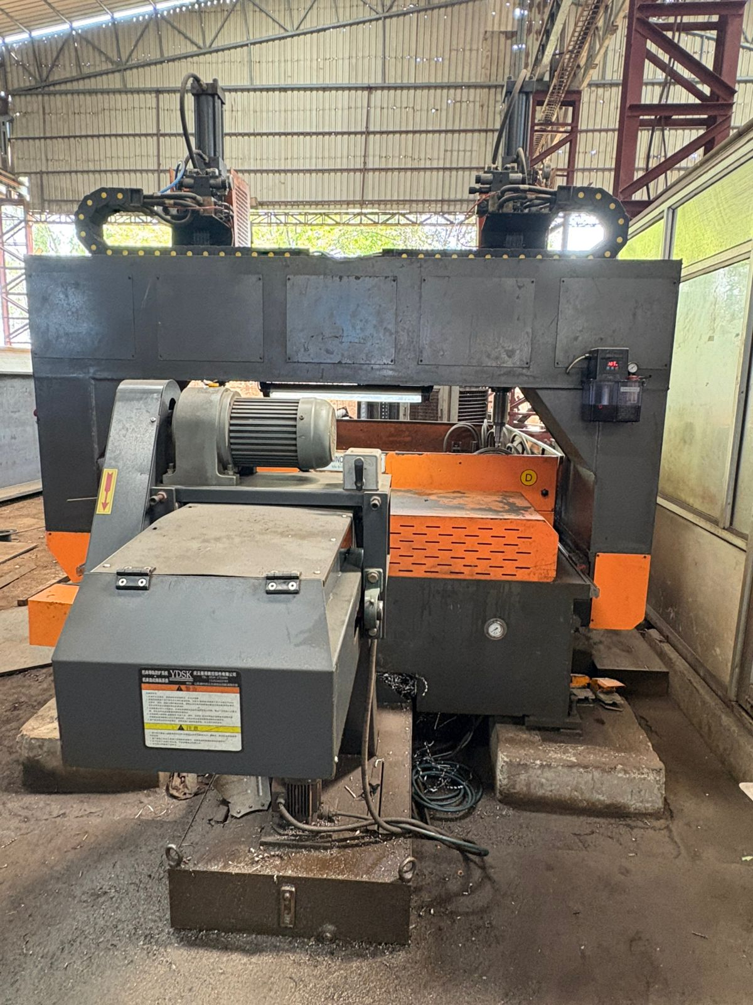
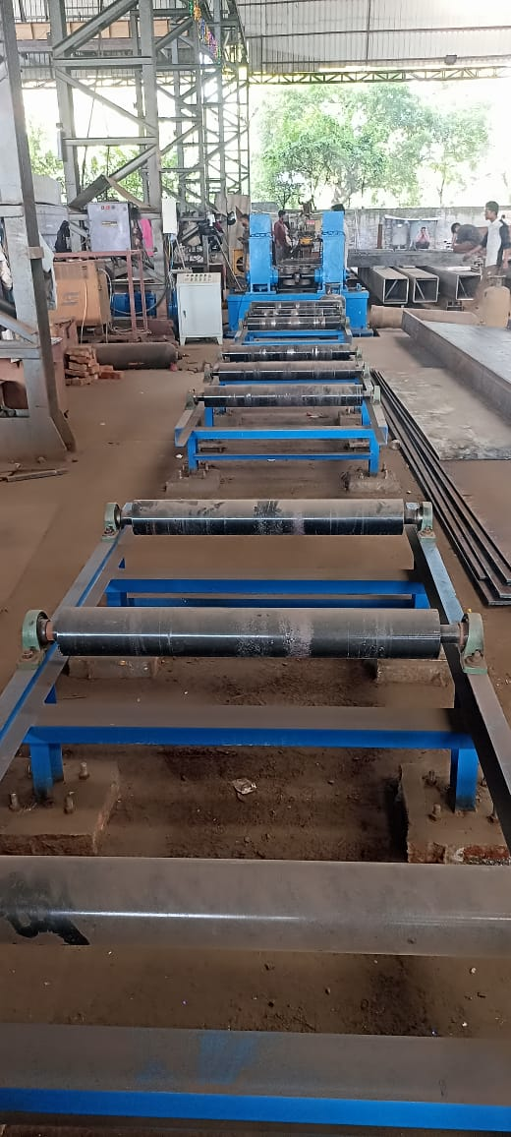
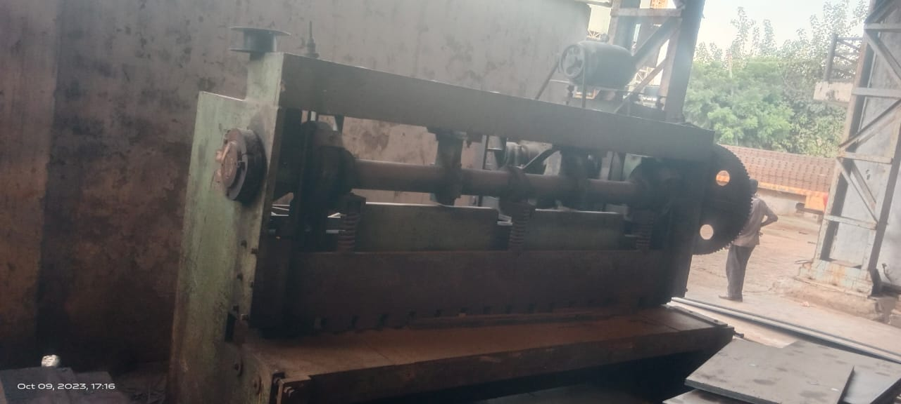
PLANT & EQUIPMENT
CNC DRILLING
BEAM STRAIGHTENING
HYDRAULIC PRESS

Slide 9
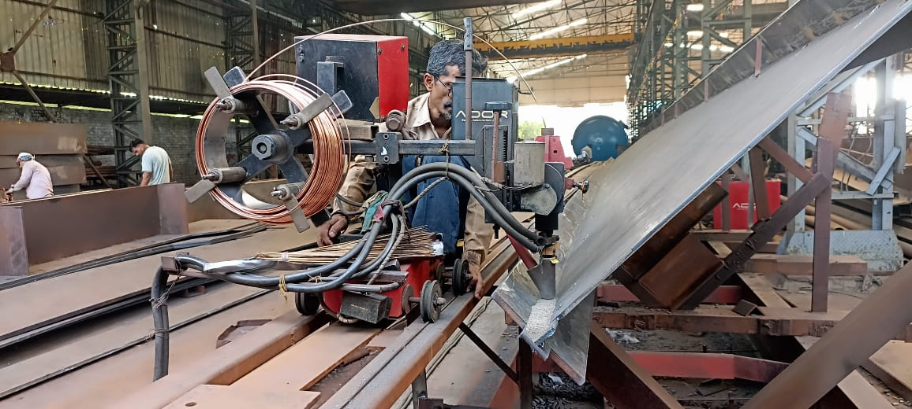
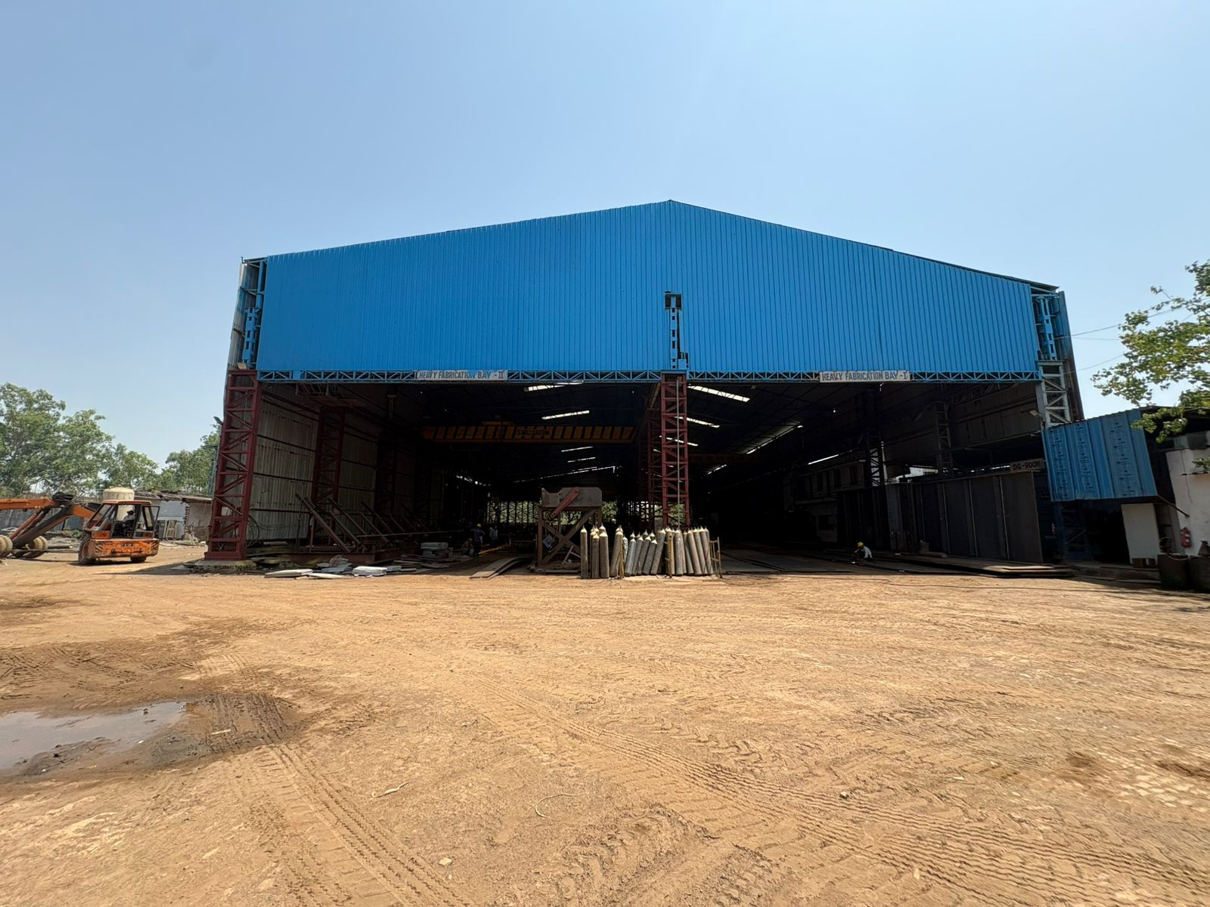
PLANT & EQUIPMENT
Beam Welding
FABRICATION BAY

Slide 10
Erection & Launching Facility
Winch Machines - 8 Nos. with capacity of 10 MT each
CC cribs - 400 Nos, Used for material stacking and temporary support
Derrick – 3 Nos used for manual erection and metro stations
Wooden Sleepers – 1000 Nos, used during launching process
Temporary Structure – 200 MT, used during launching of girders
Pulleys, Turnbuckles, Slings, D-Shackles available as per requirement
Mobile Crane - Partnership with various vendors in Delhi, NCR region

Slide 11
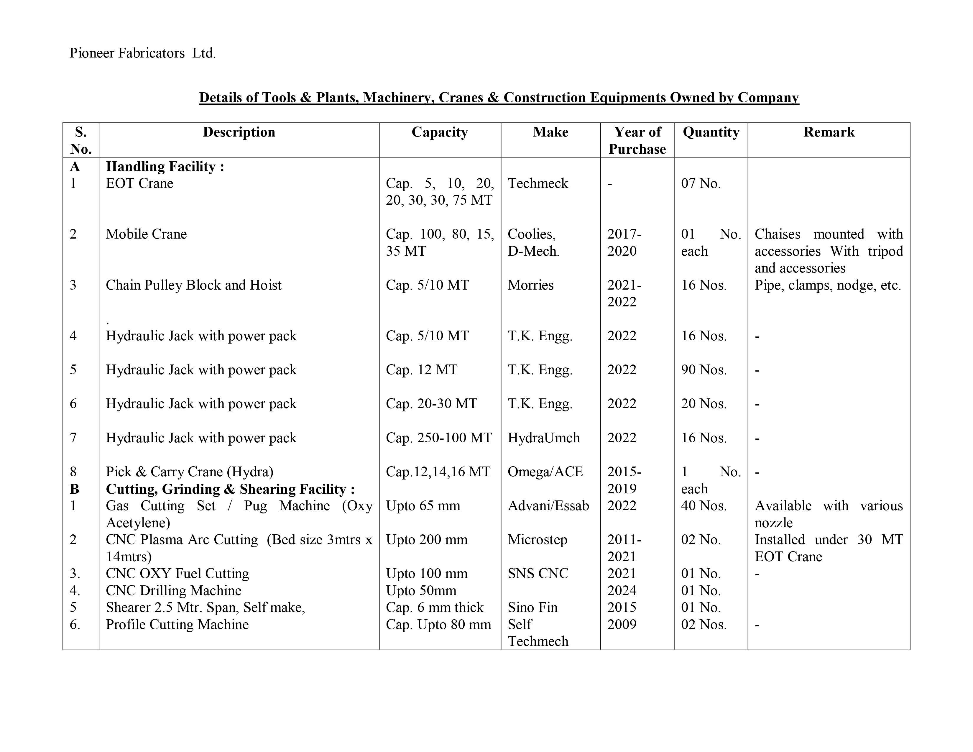
Machine List

Slide 12
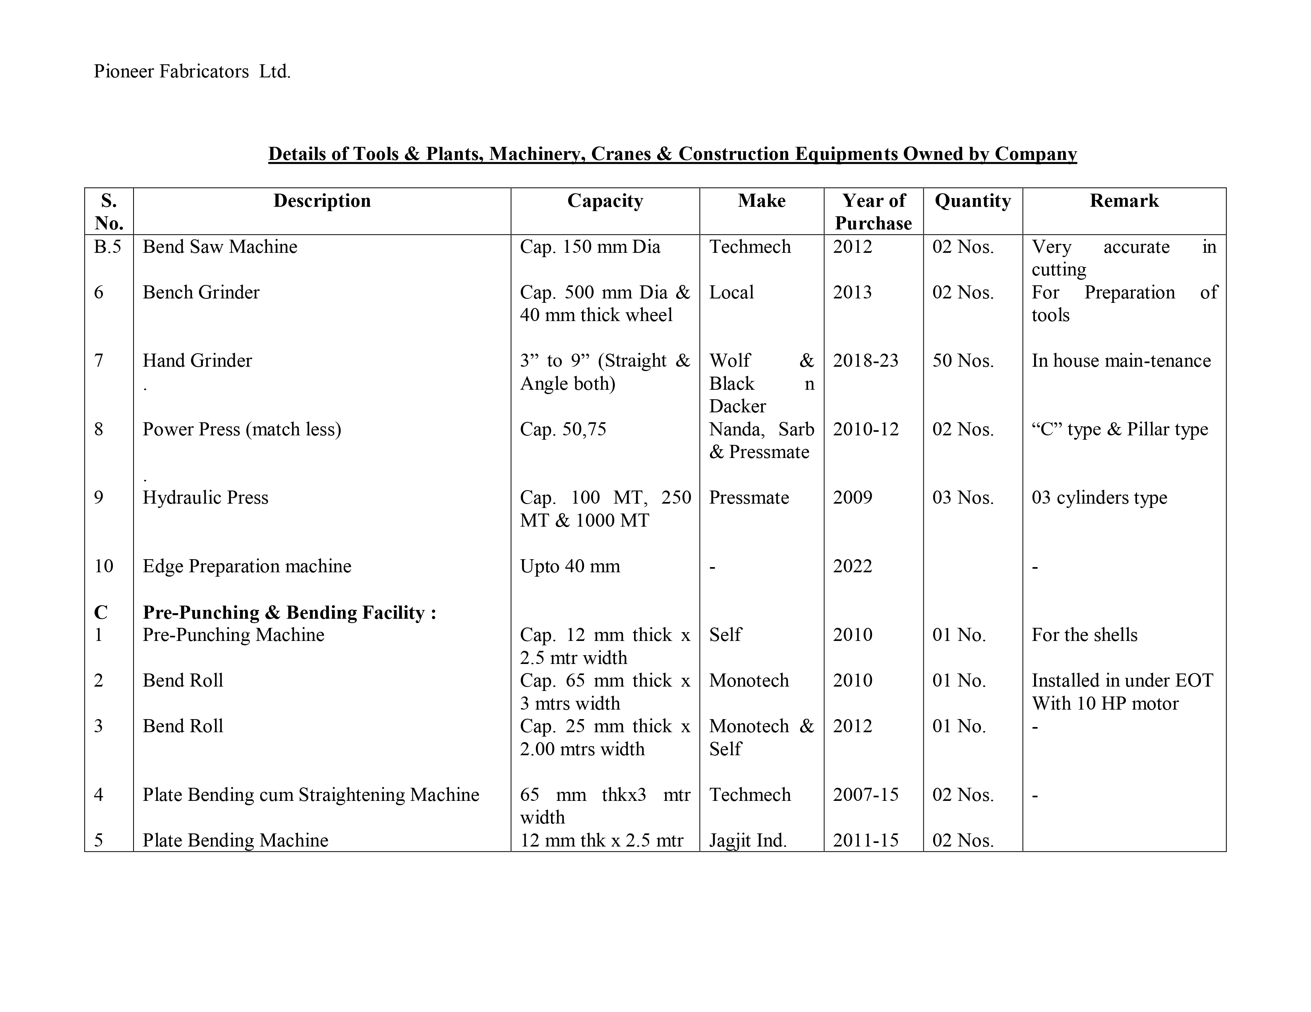
Machine List

Slide 13
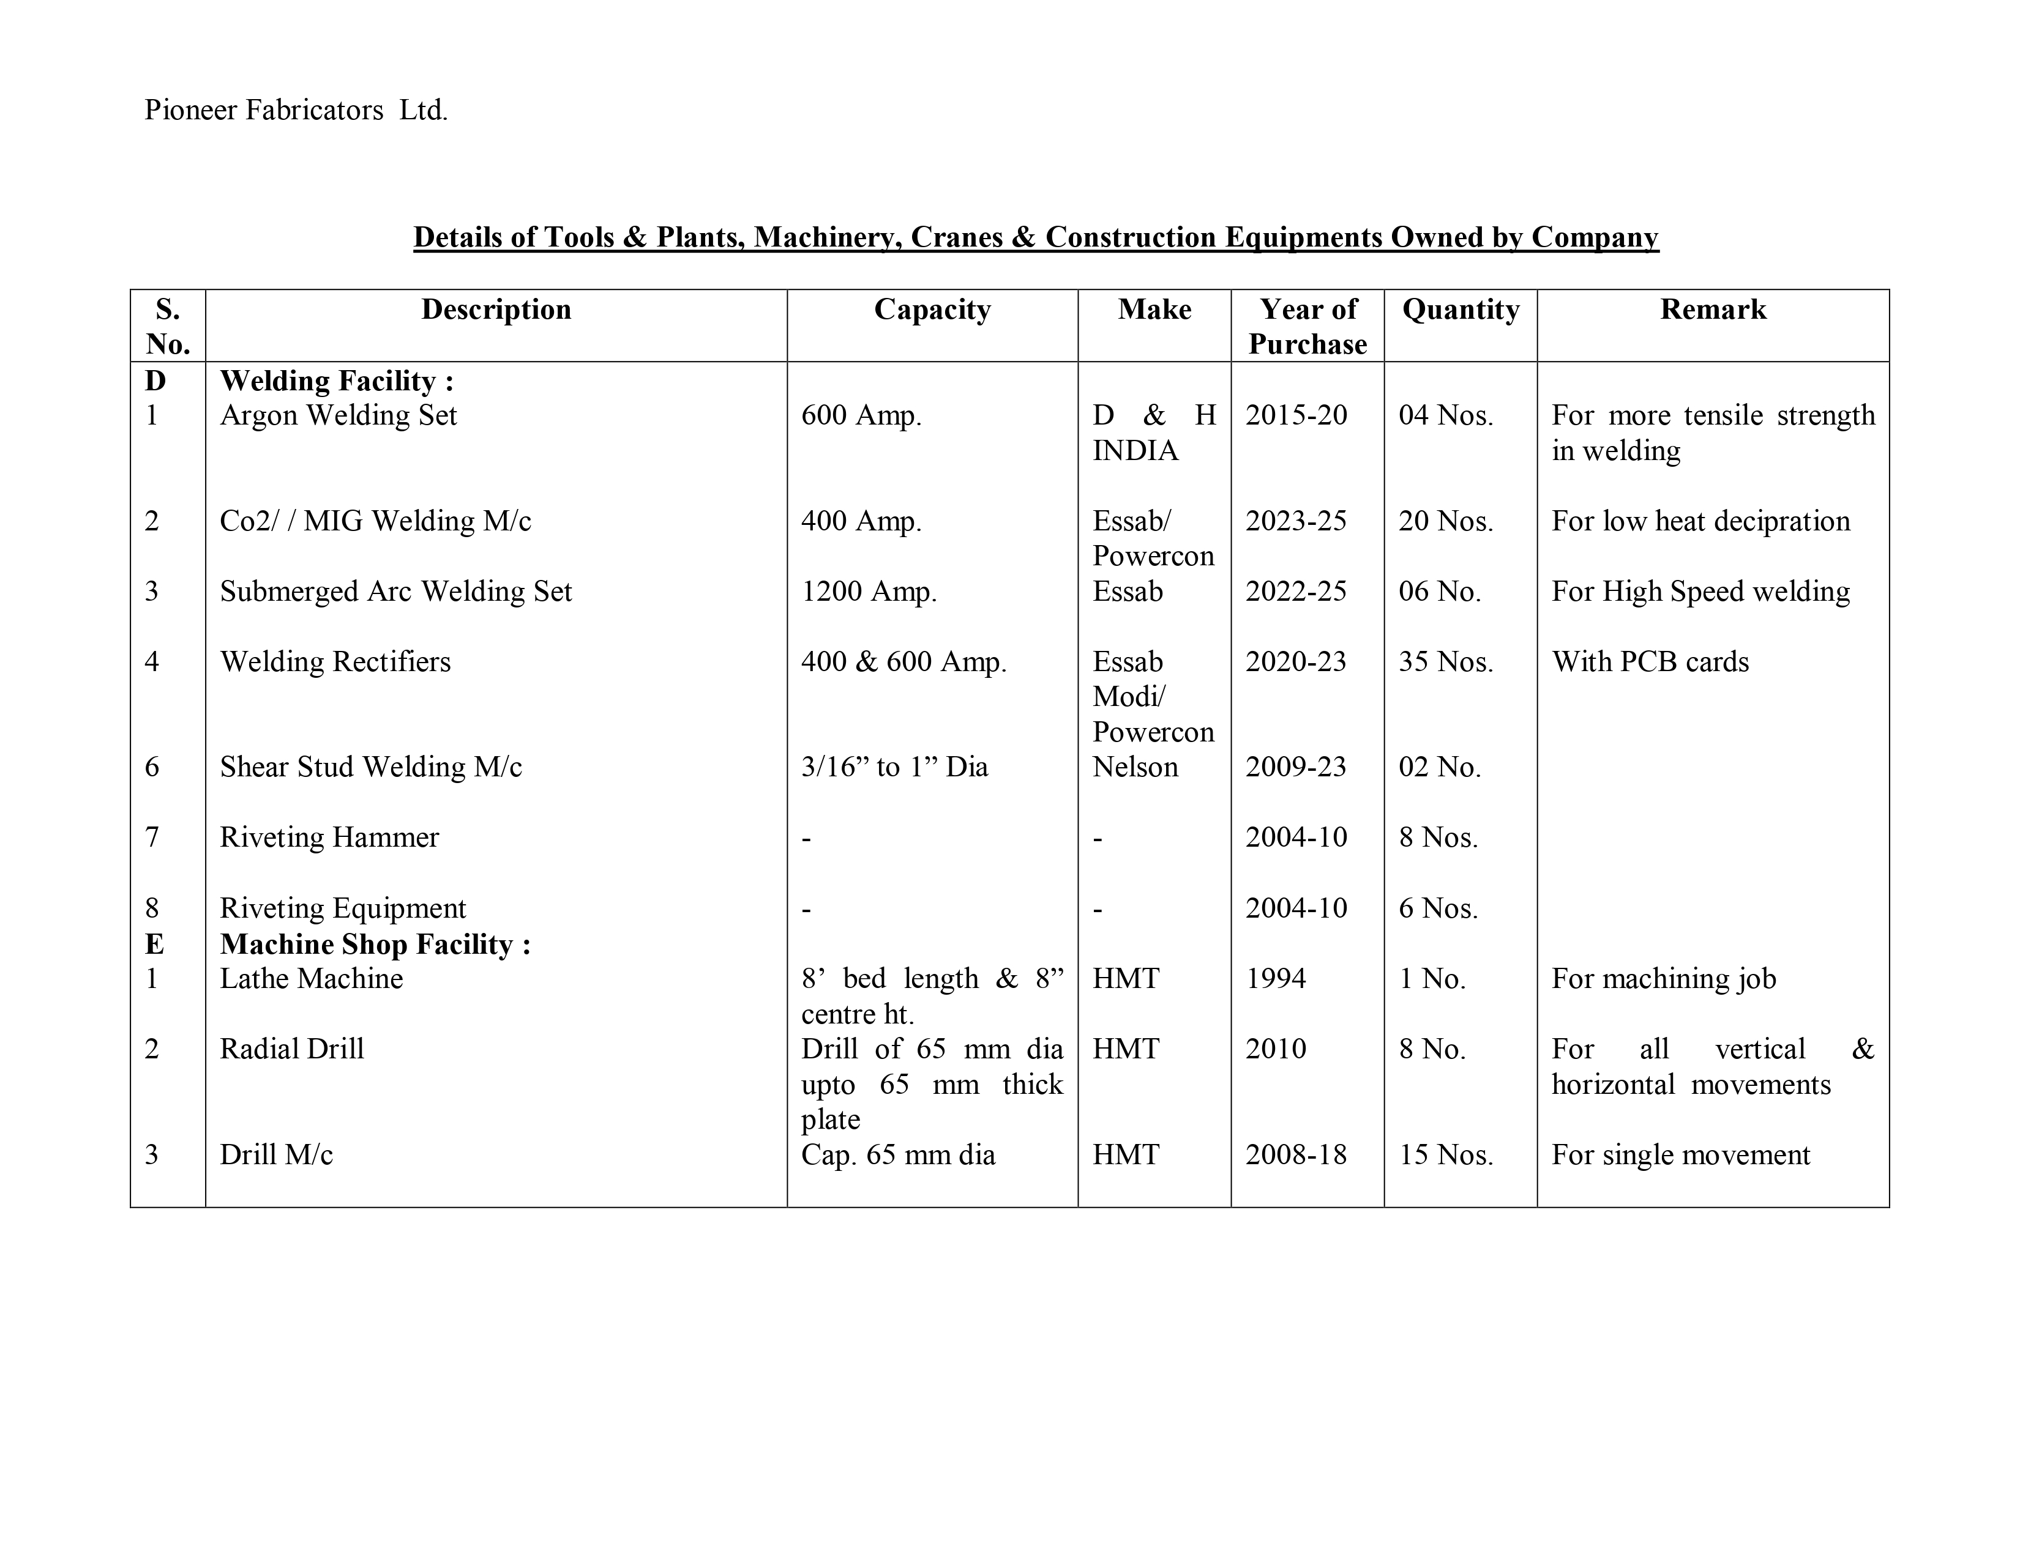
Machine List

Slide 14
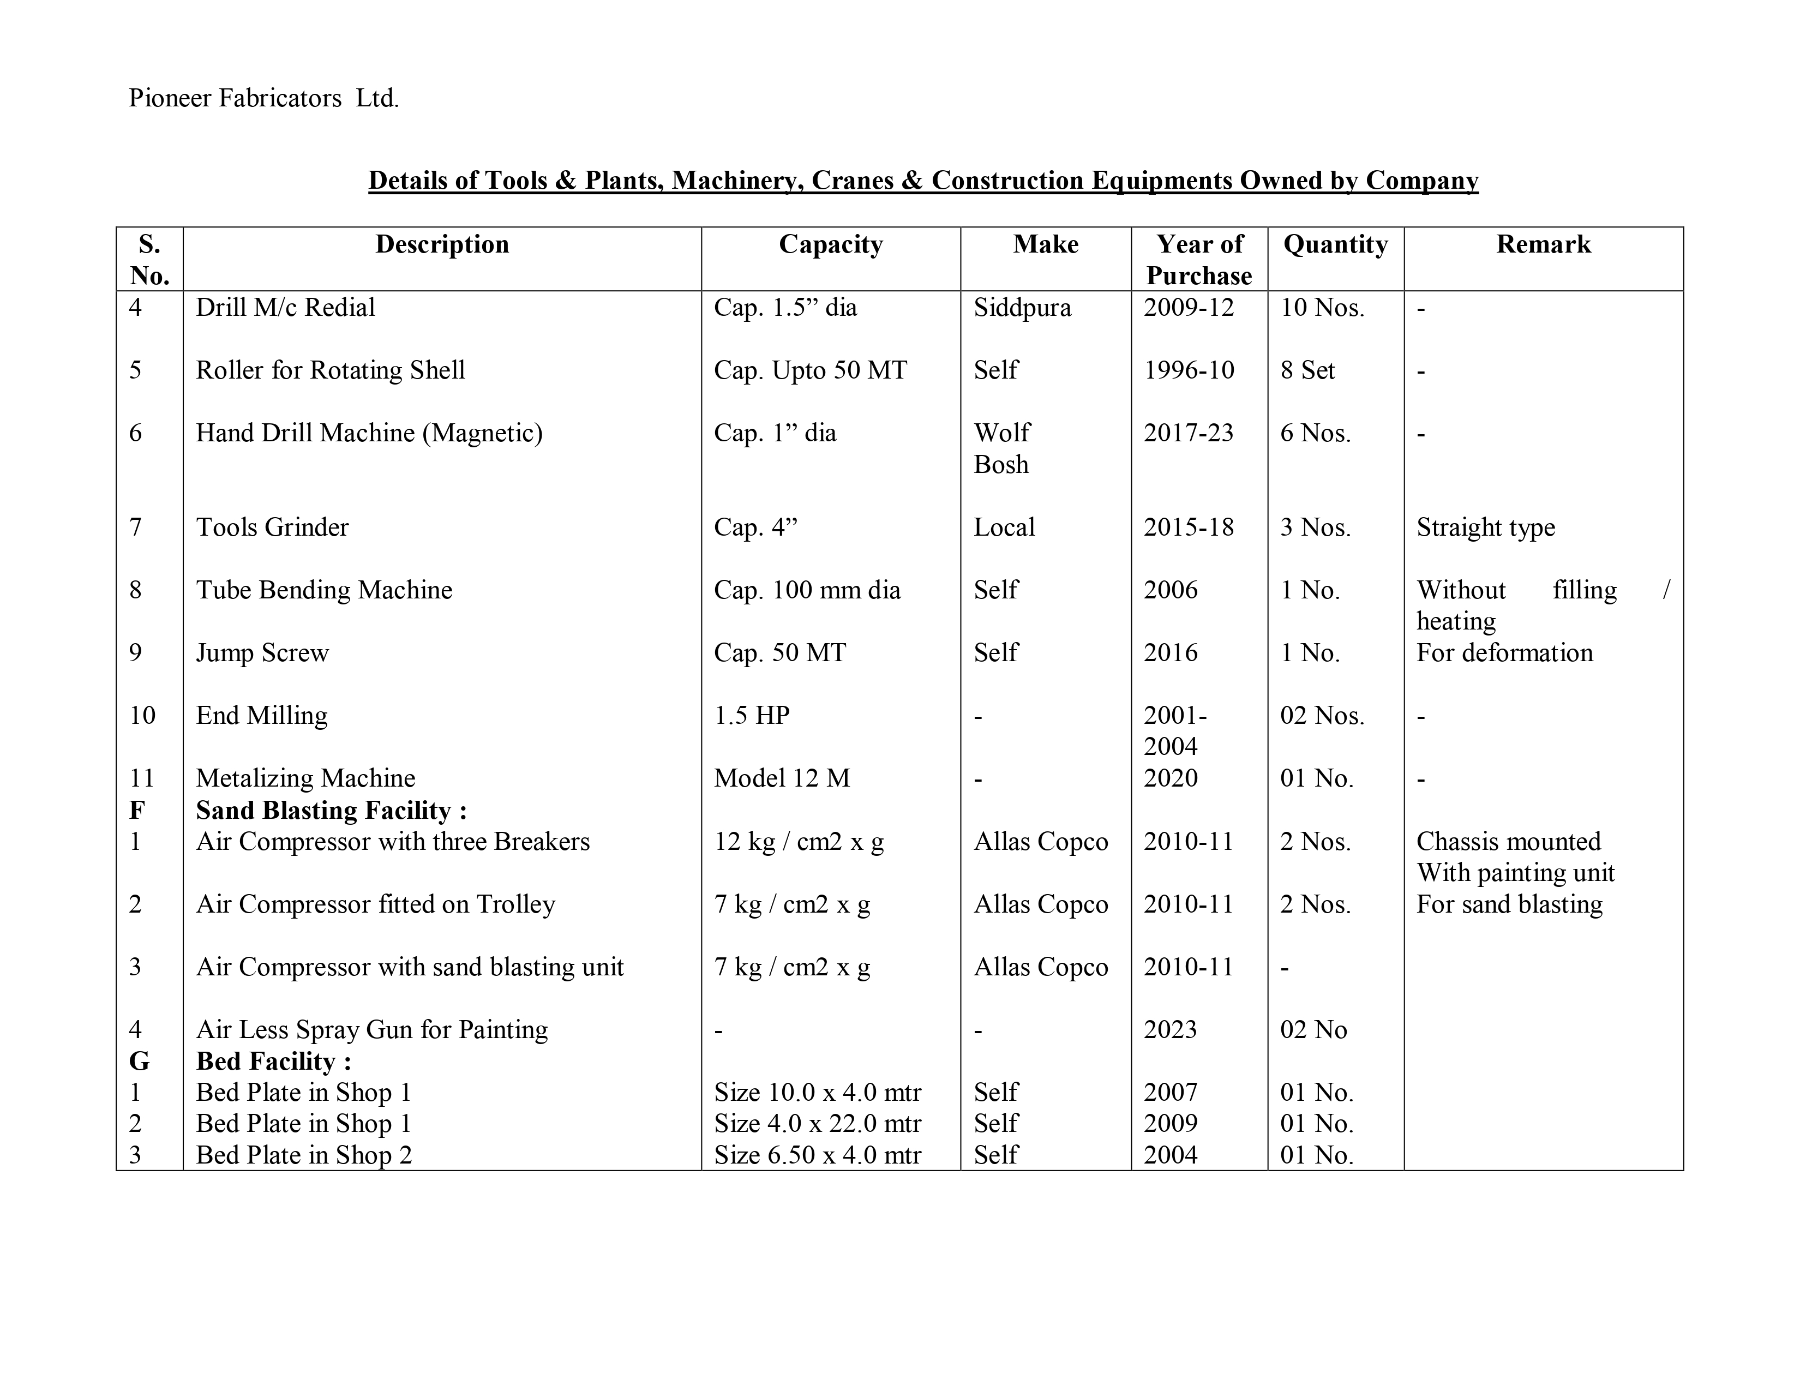
Machine List

Slide 15
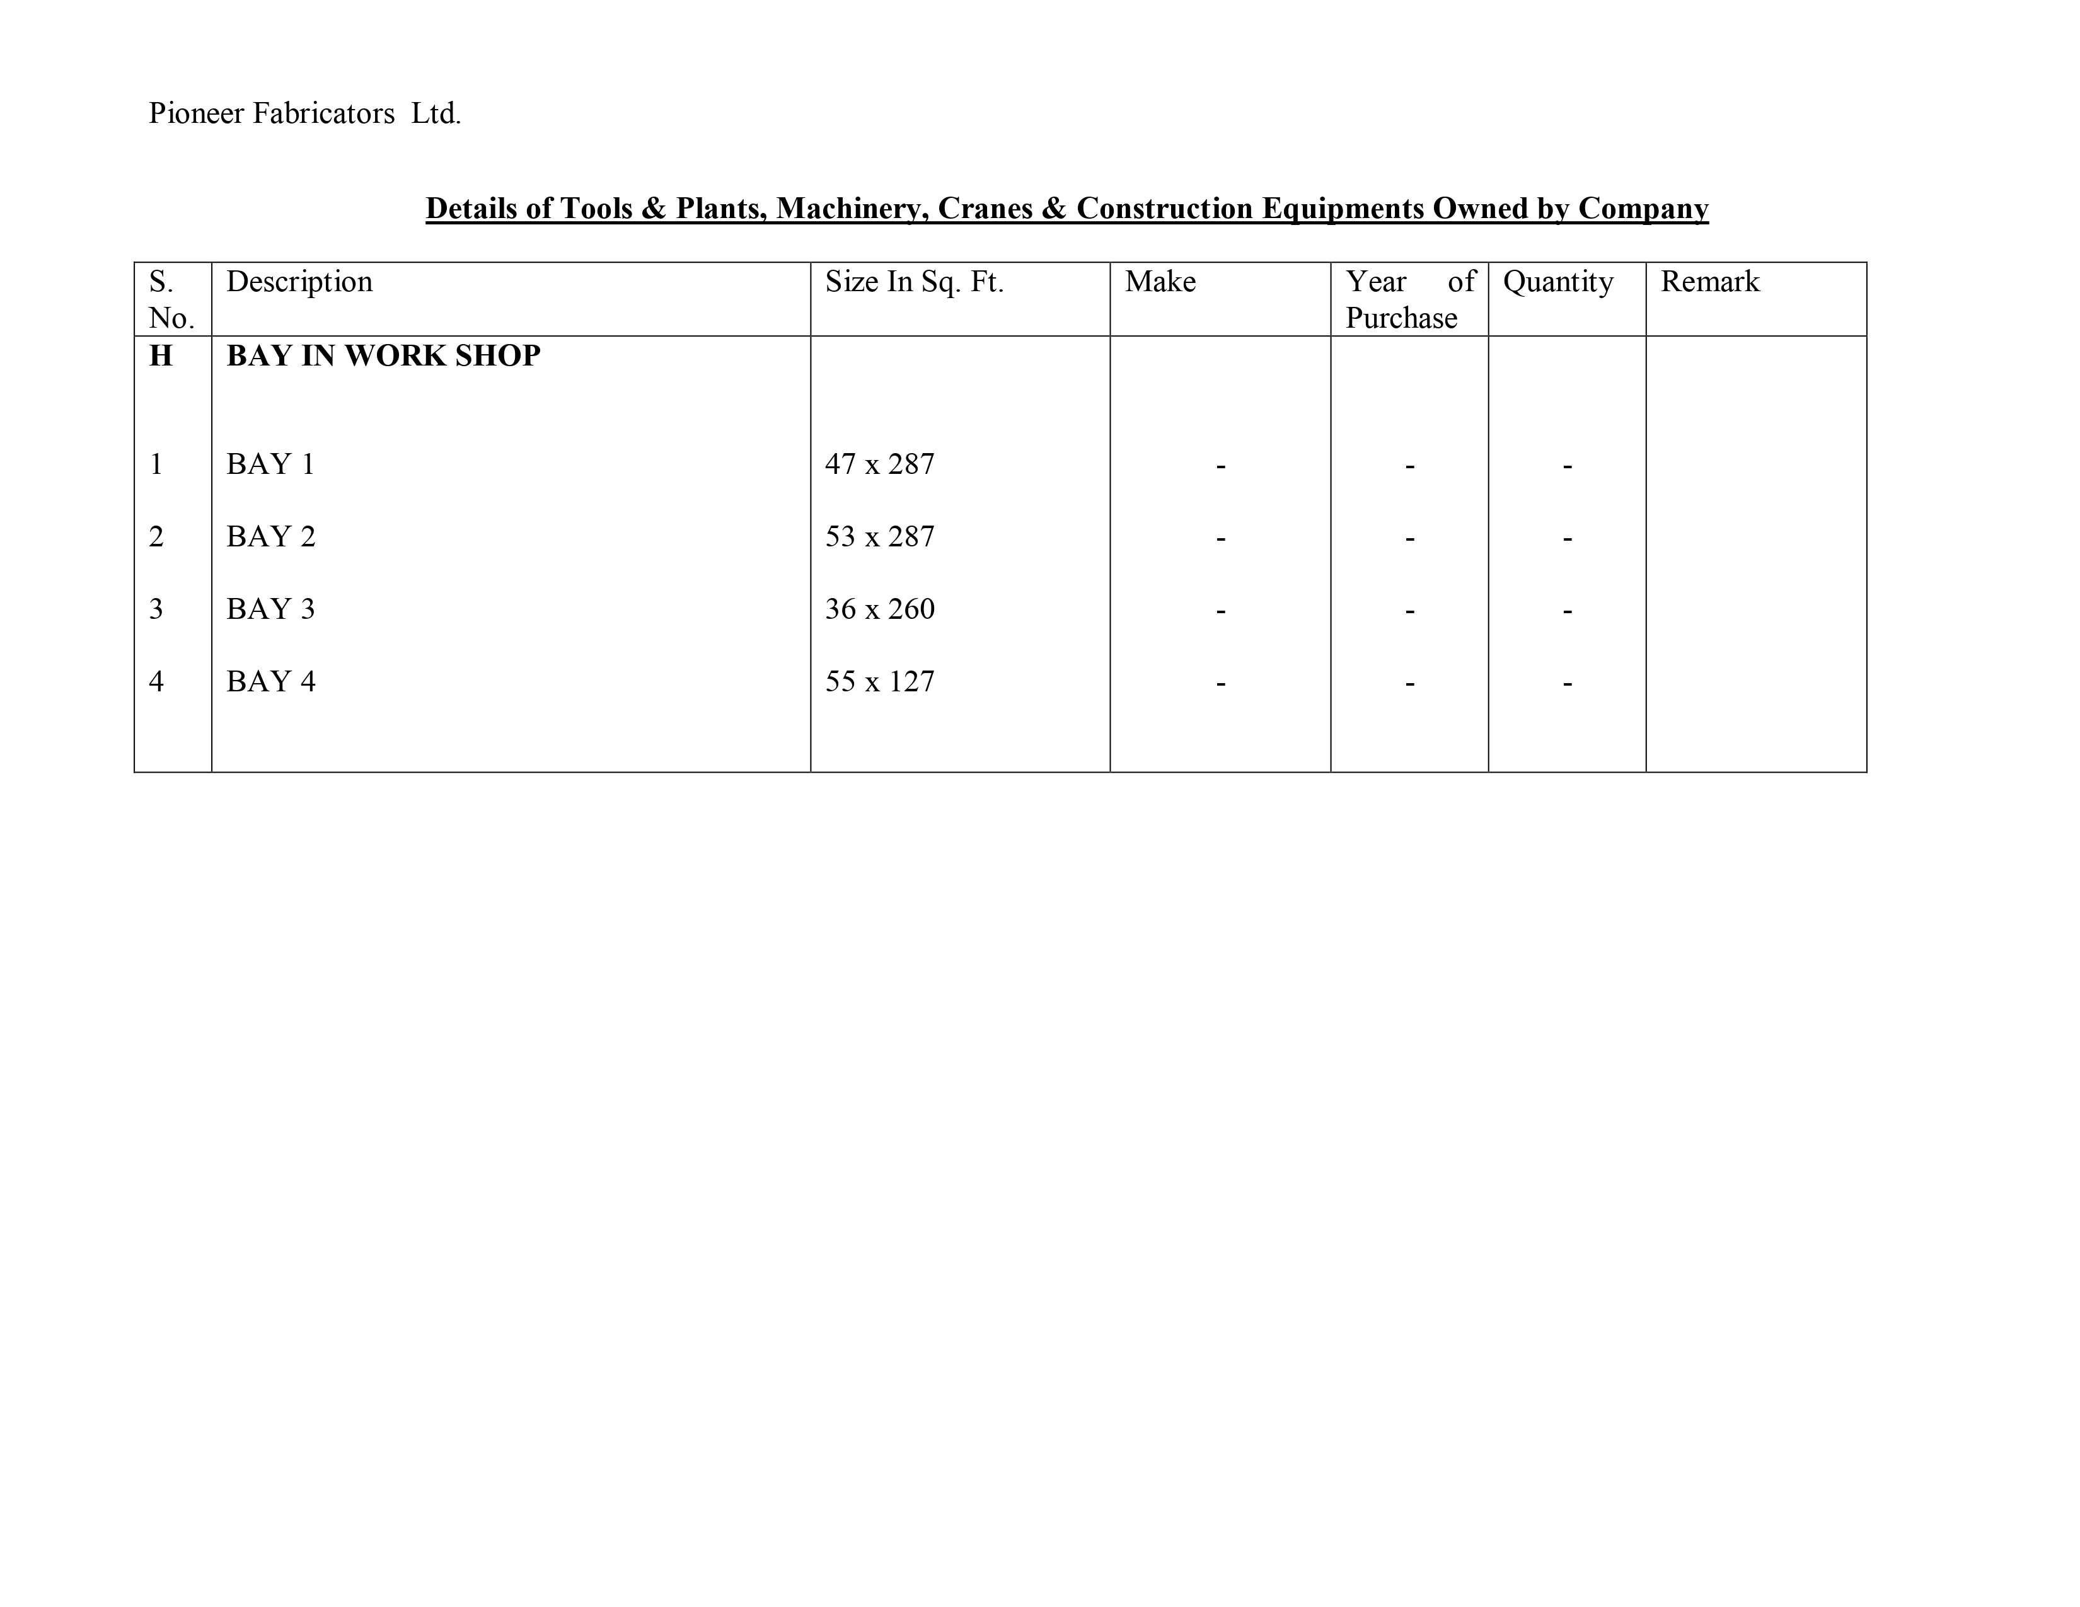
Machine List

Slide 16
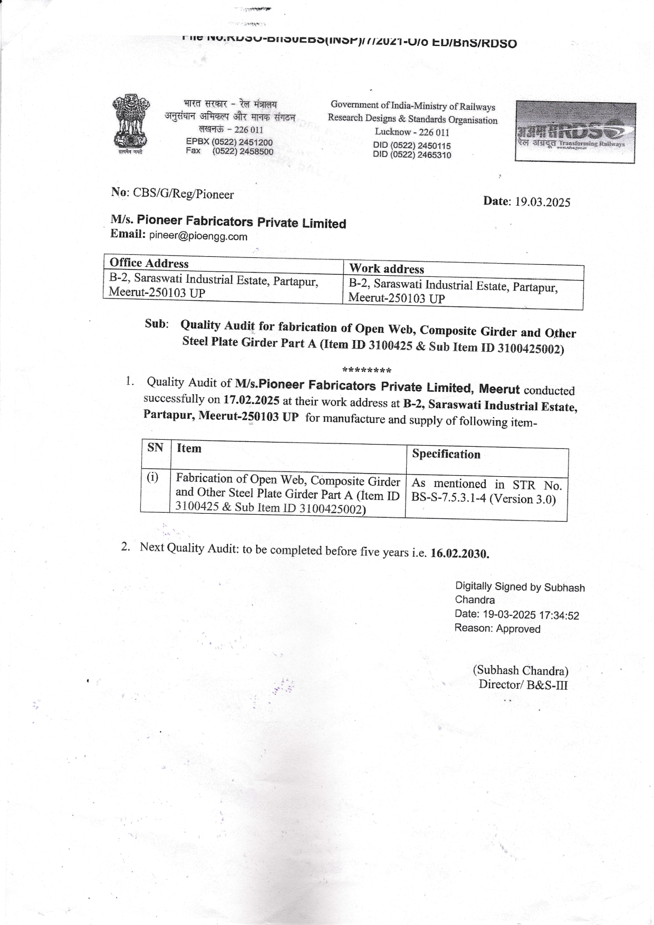
RDSO APPROVAL
Registration ID- 14062
Annual Production Capacity- 10000 MT

Slide 17
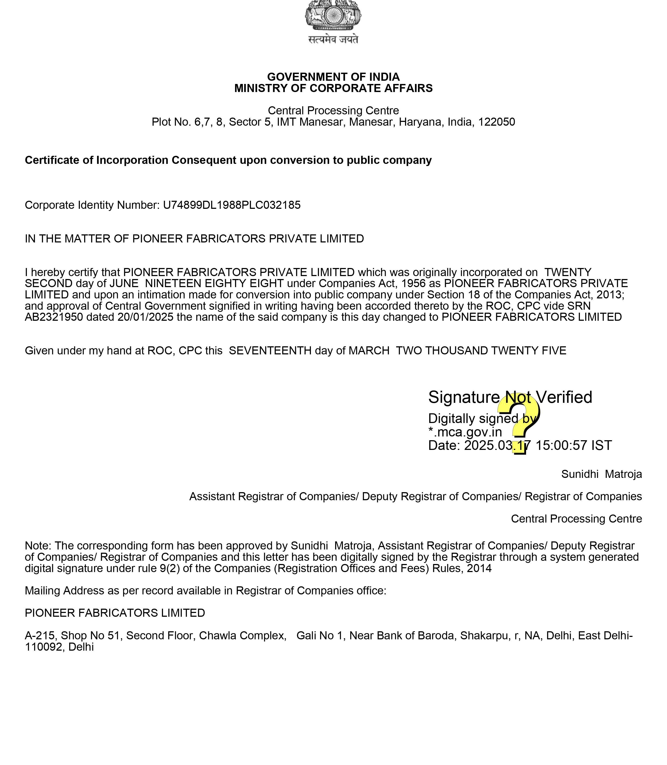
FIRM REGISTRATION DETAIL

Slide 18
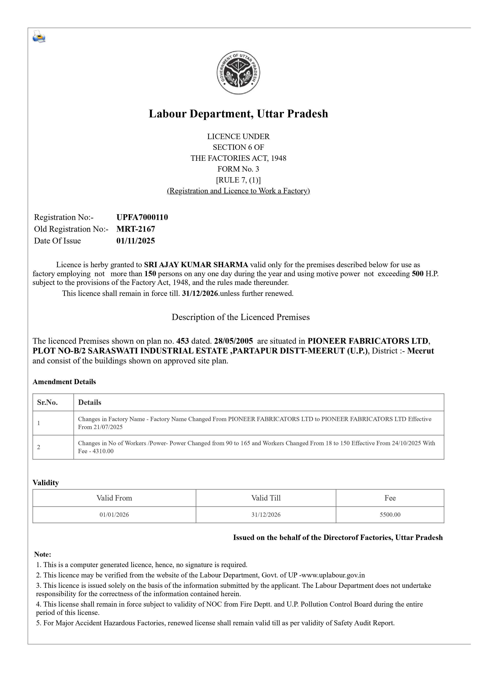
FACTORY LICENSE

Slide 19
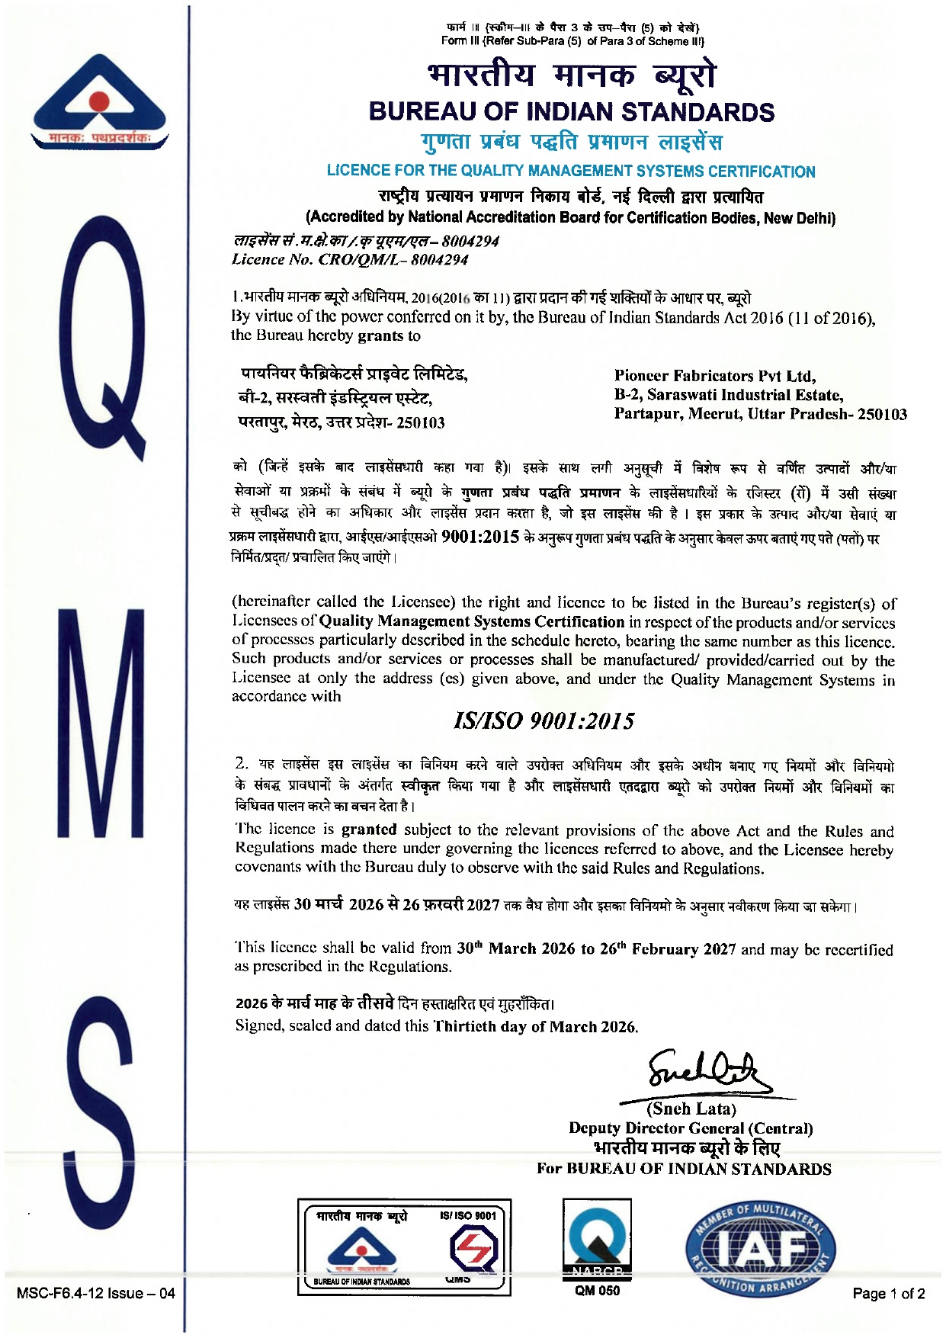
ISO 9001

Slide 20
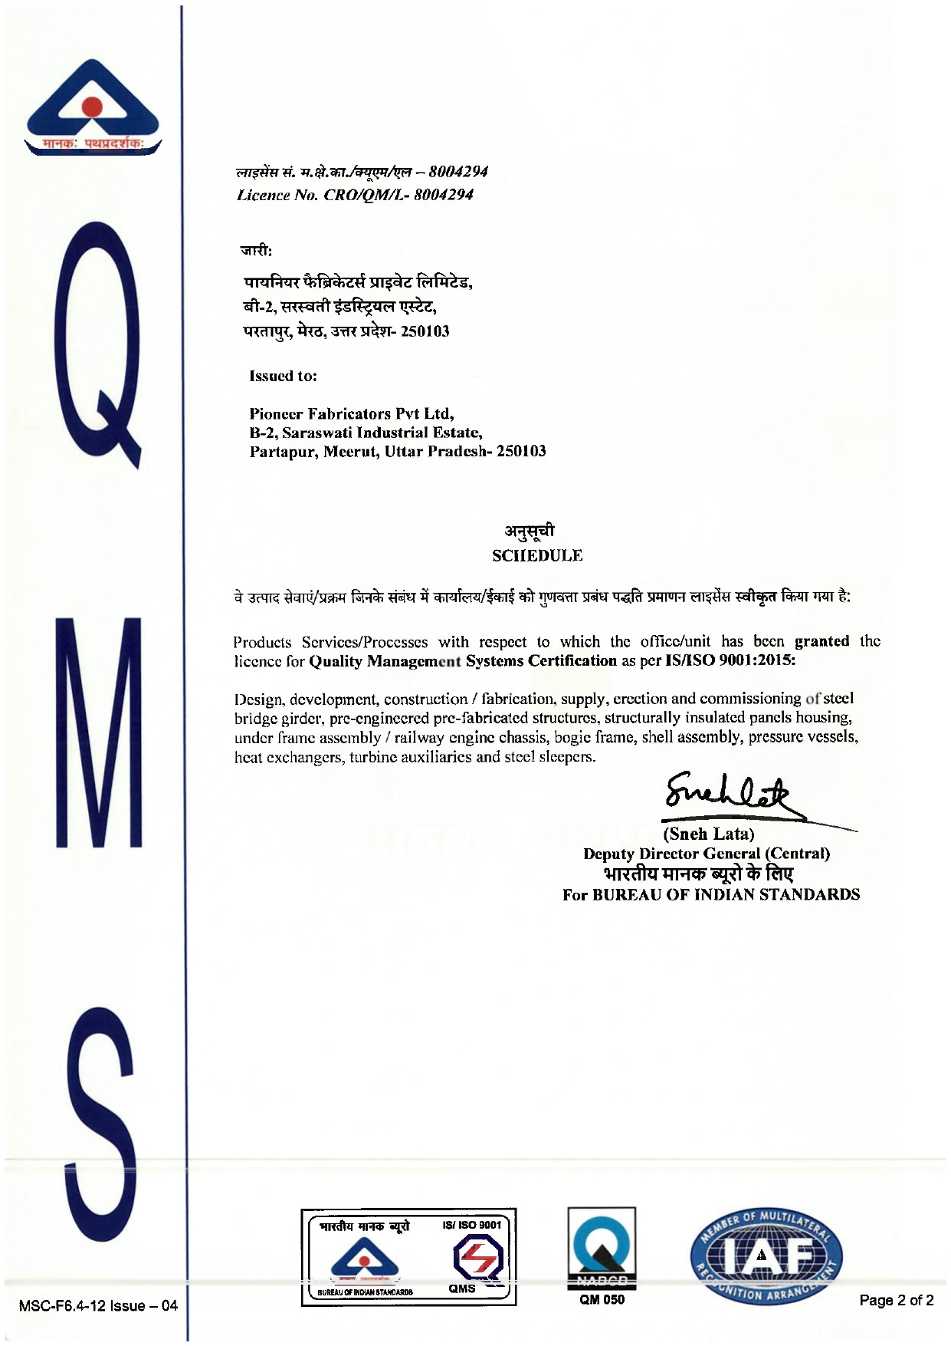
ISO 9001

Slide 21
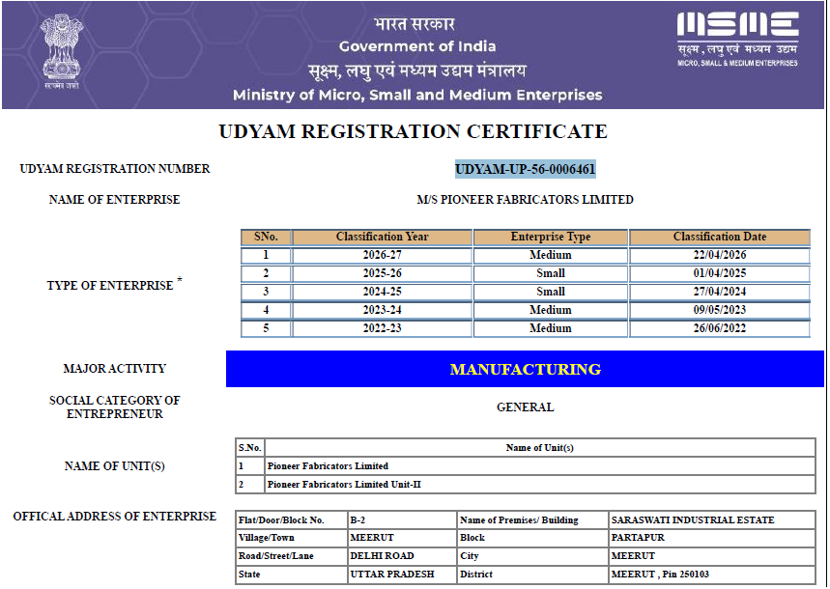
Udyam

Slide 22
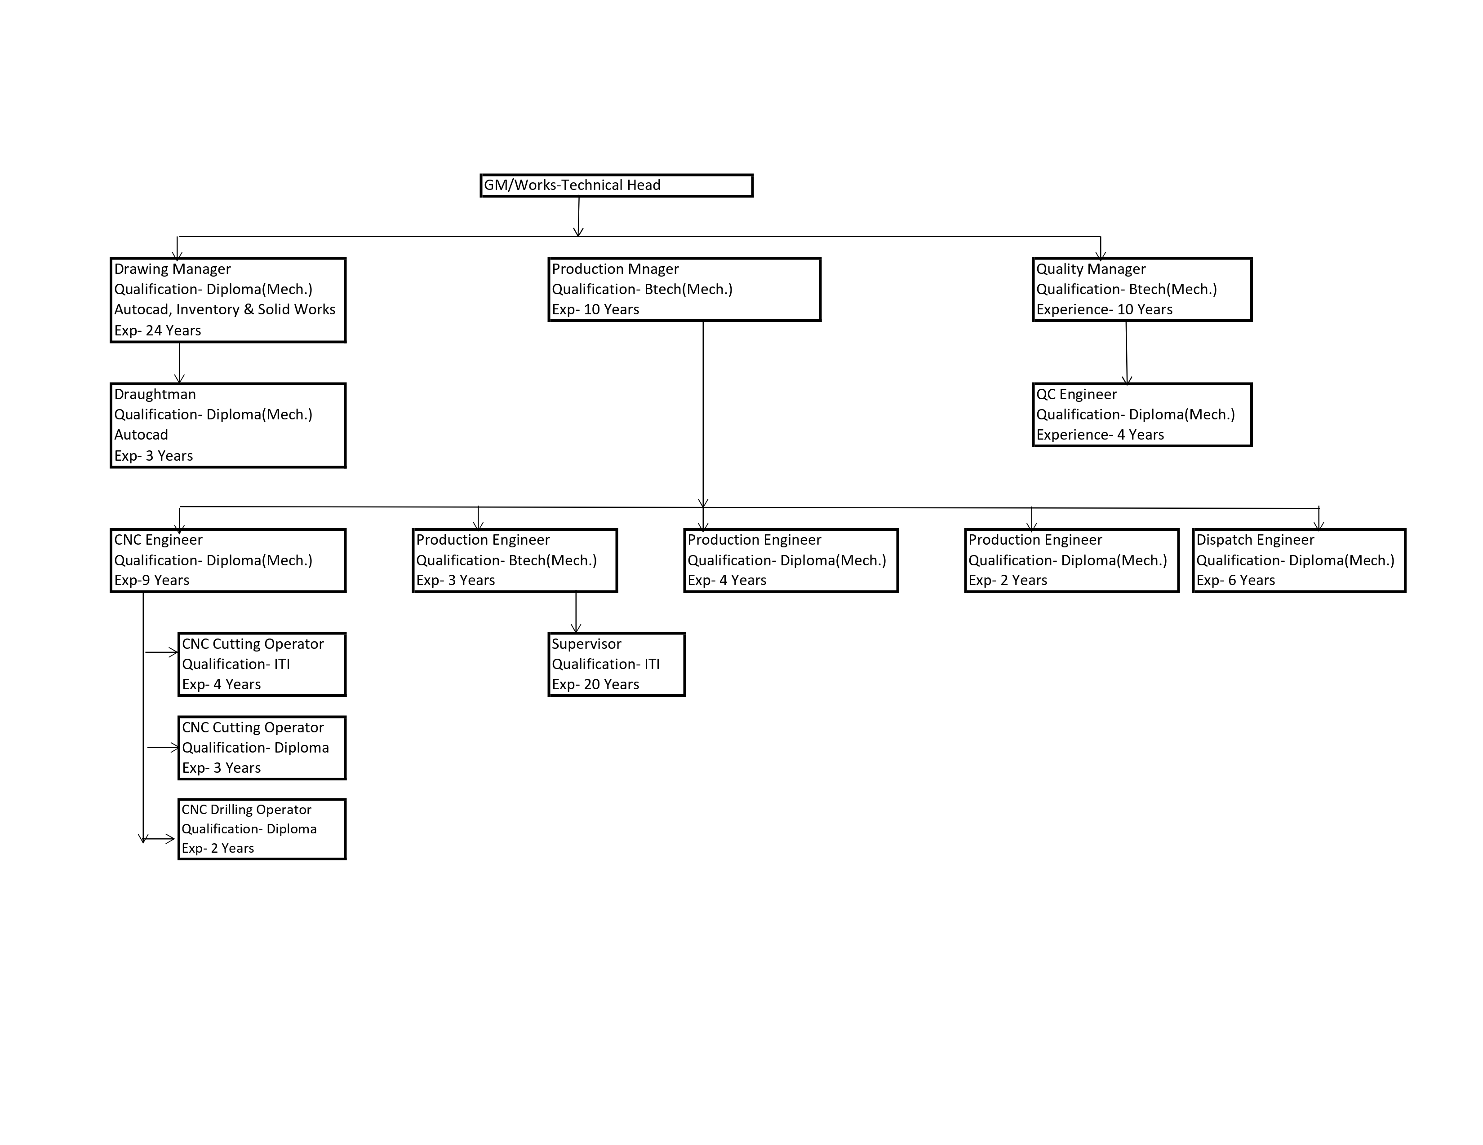
Organization Chart

Slide 23
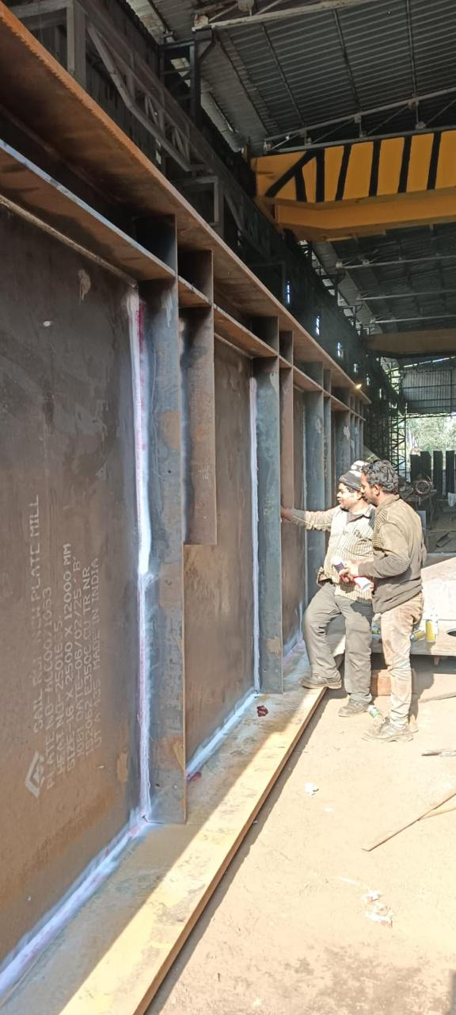
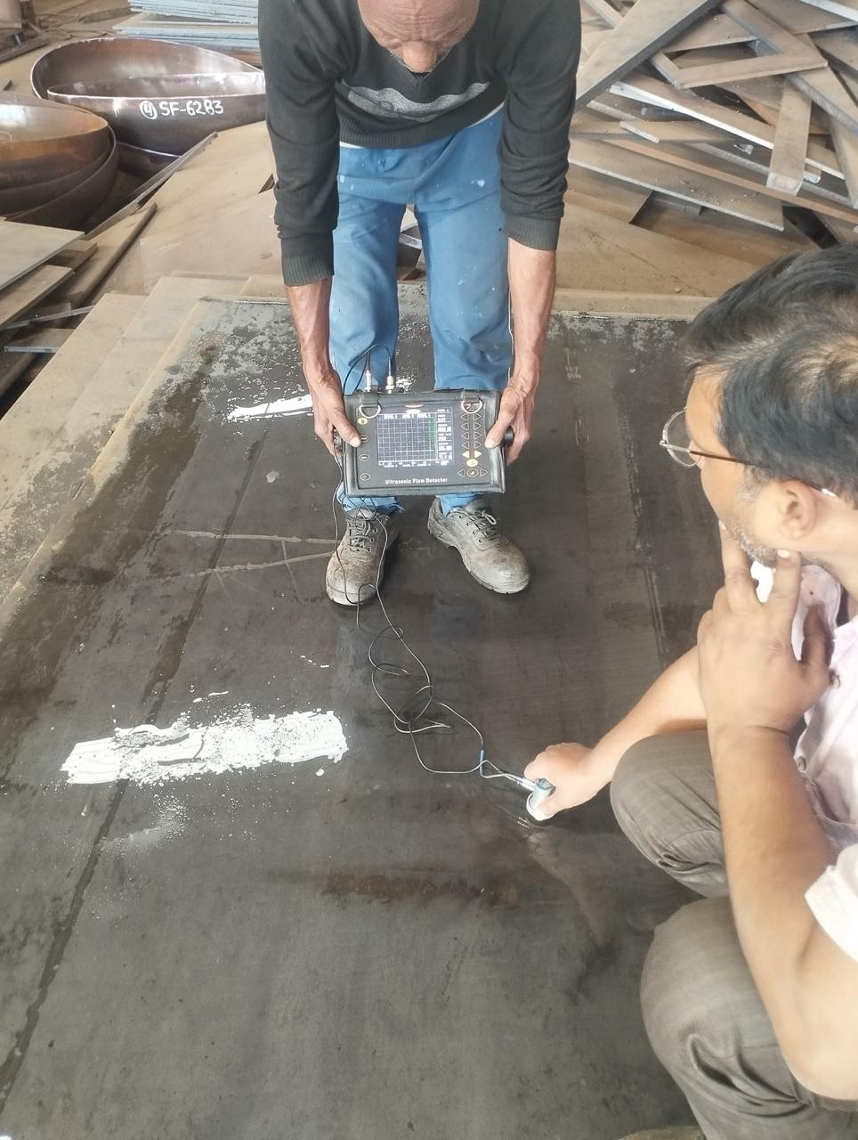
QA-QC PROCESS
DPT- Inhouse
UT- Inhouse
PAUT- Outsourced
Chemical and Mechanical Testing- Outsourced from NABL approved Lab

Slide 24
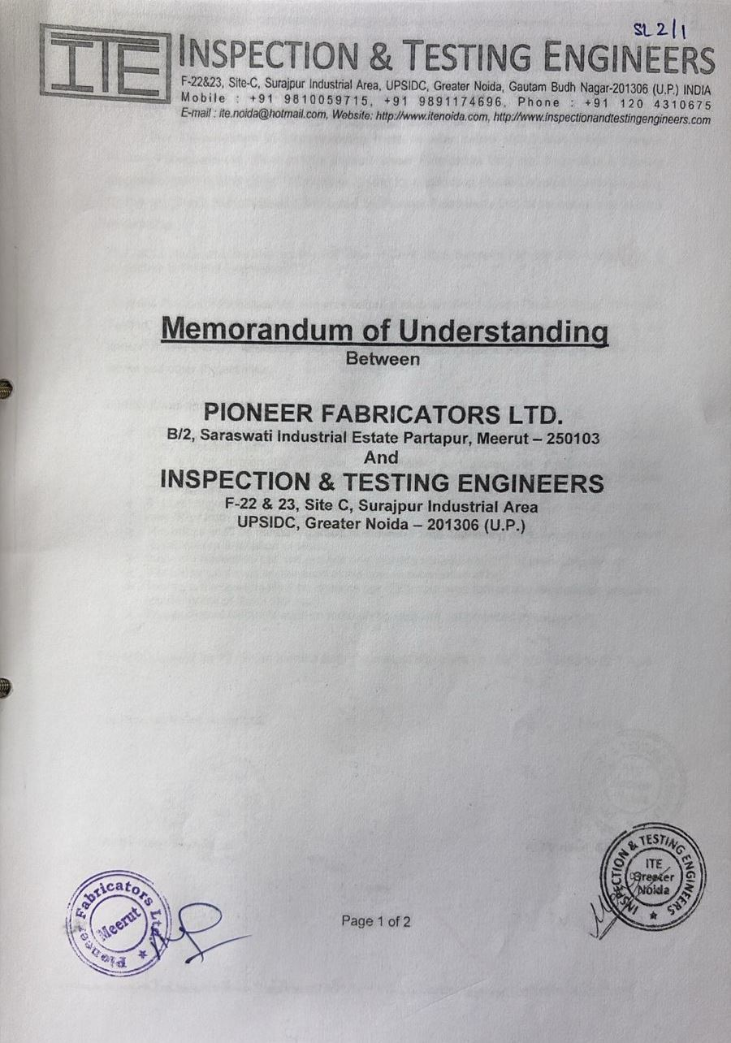
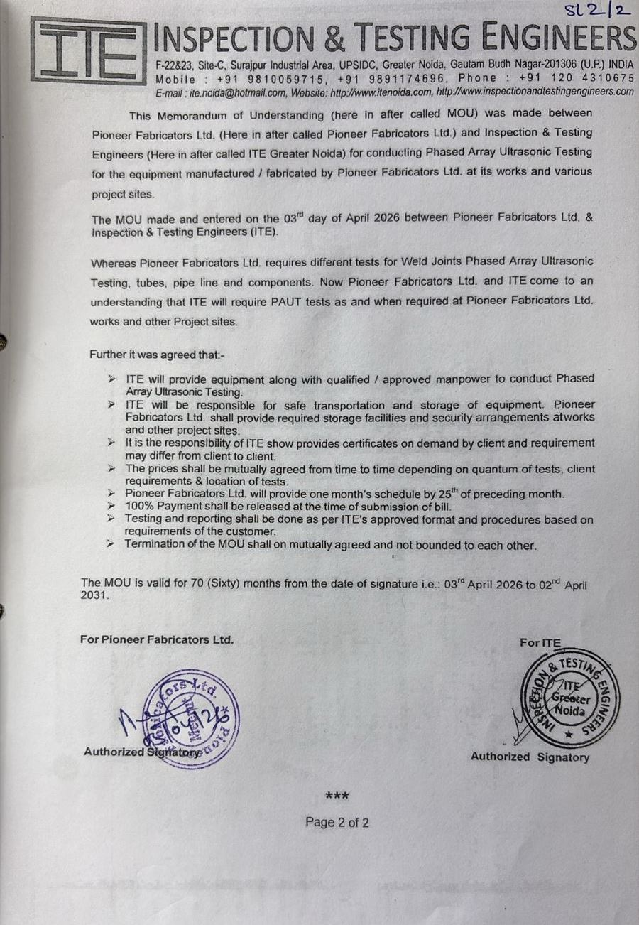

Slide 25
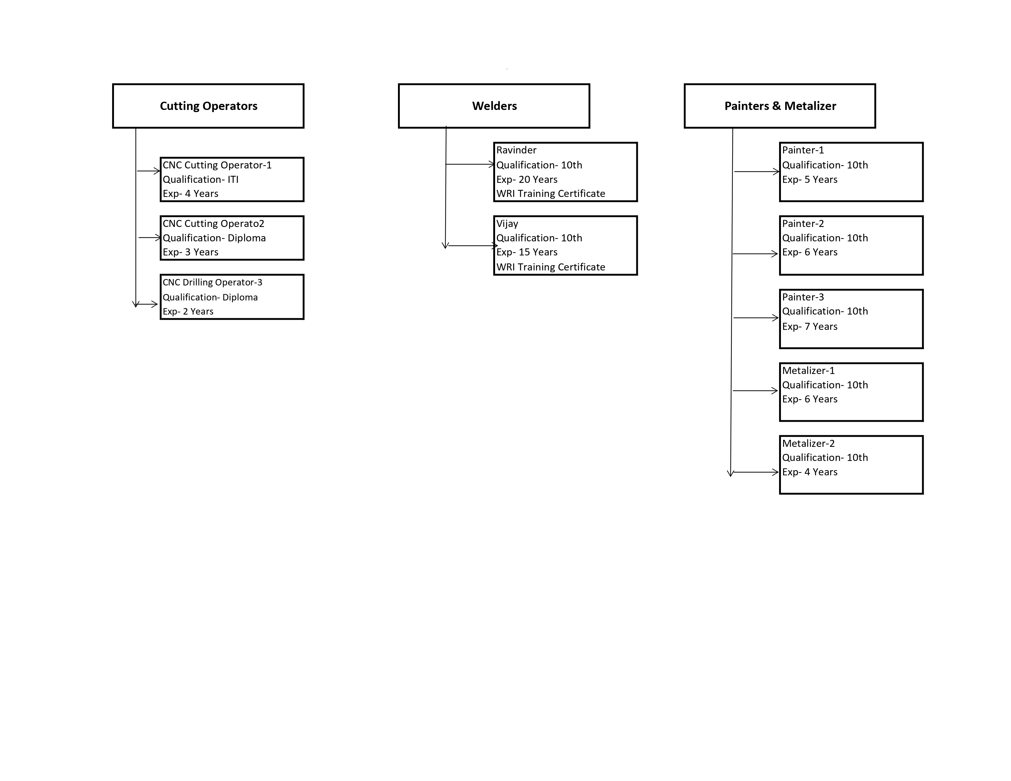
Artisans- Involved in Cutting, Welding, Drilling, Blasting, Metalizing & Painting

Slide 26
Fabrication UNIT
Address- B-2 Saraswati Industrial Area, Partapur (Meerut)- 250103
Fabrication Shop
Template Area- Bed Plate in shop
10mtr x 4mtr
4mtrx 22mtr
6.5mtrx 4mtr

Slide 27
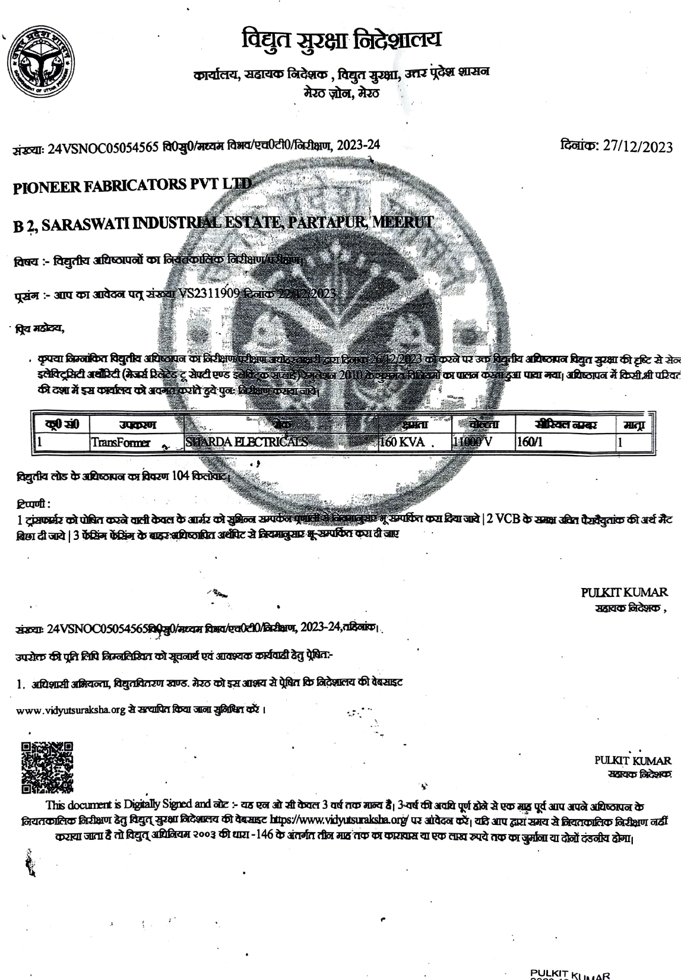
Power Demand-
Installed Power Supply-

Slide 28

One Stop Solution Provider of all Railway Engineering, Structural Fabrication and Galvanizing Needs
Pioneer Fabricators Ltd.
Approved By RDSO, B & ISO 9001:2015 Certified Company
“DESIGNERS, ENGINEERS, FABRICATORS & CONTRACTORS”
Office & Works
B - 2, Saraswati Industrial Estate, Partapur, Meerut – 250 103
Email: pioneer@pioengg.com
Visit us: www.pioengg.com
www.piofab.com

